Slide 1
Sturgeon Refinery Update
Life in the Heartland Community
Information Evening
October 20, 2022

Slide 2
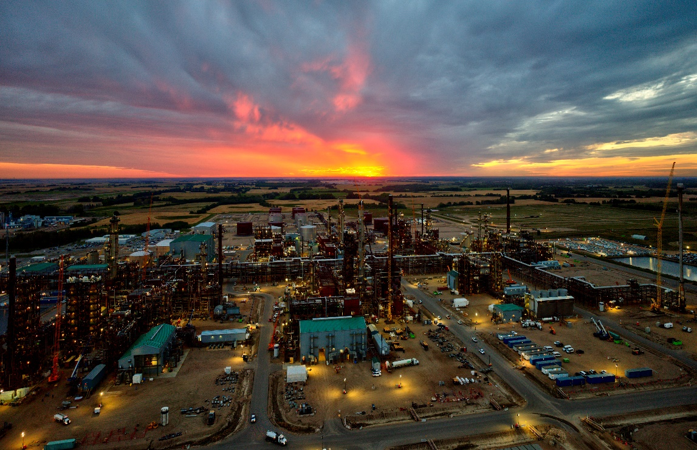
Sturgeon Refinery About Us
Our Sturgeon Refinery is the first of its kind built in Canada in over 35 years.
Designed to minimize our environmental footprint through carbon capture and storage.
We’ve been producing diesel and other products since December 2017.
In 2021, we surpassed five million exposure hours of lost-time incident-free work.
2021 marked our first full year of commercial operations.
2
2

Slide 3
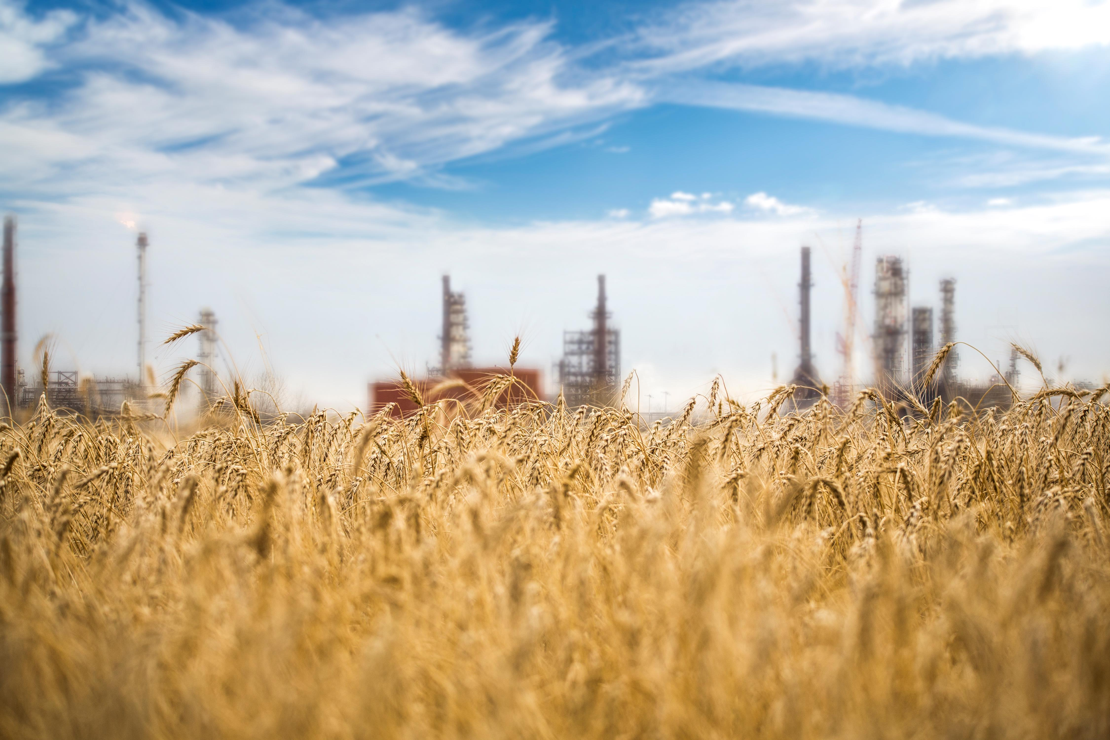
Sturgeon Refinery Our mission
To build, operate and grow a safe, profitable and
environmentally responsible bitumen refinery creating
high-value products for Alberta and the world.
3
3

Slide 4
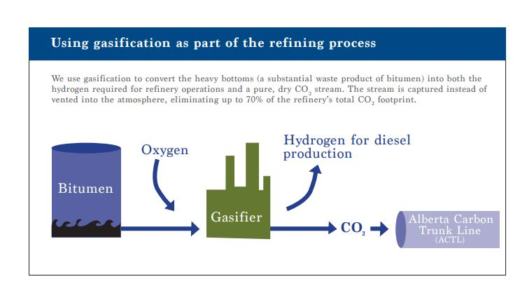
Sturgeon Refinery What we do
We convert raw bitumen into lower carbon, ultra-low sulphur diesel with minimum impact on the environment.
The CO₂ from the refinery process is captured, compressed and shipped about 240 km to central Alberta along the Alberta Carbon Trunk Line.
The CO₂ is then used for enhanced oil recovery before it’s permanently stored underground.
Photo Placemarker
4
4

Slide 5
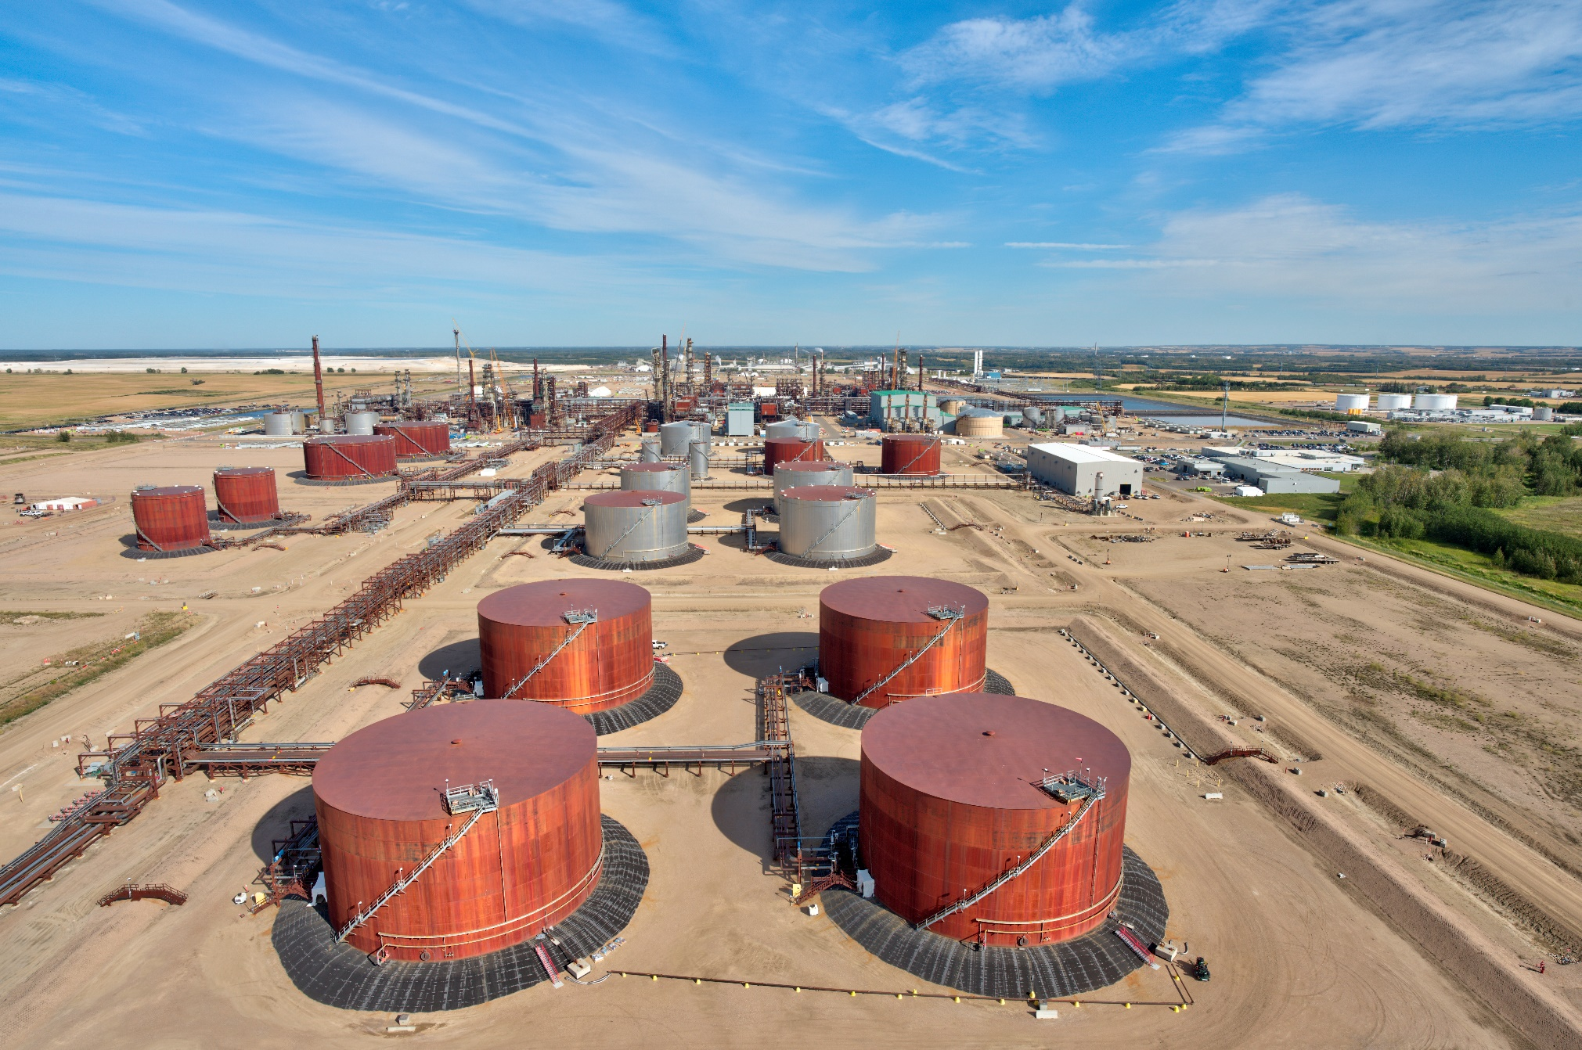
Sturgeon Refinery 2022 highlights
5
5

Slide 6
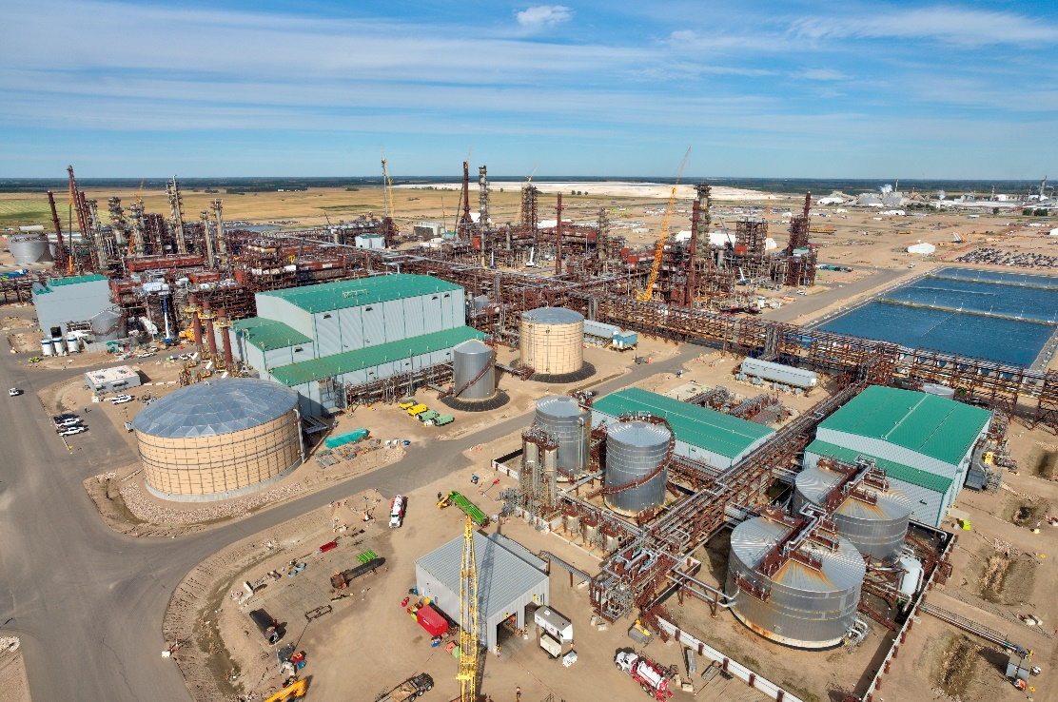
Sturgeon Refinery Turnaround Talk
Our first major Turnaround kicked off at the beginning of August.
For 55 days, over 2,000 skilled trades and supporting personnel worked day and night shifts to get the job done on time.
Over 13,000+ materials were ordered and delivered for Turnaround. The majority were sources from Alberta—as close as Gibbons—while other material is from as far as Shanghai.
Production in all 10 units at the refinery recently came to a standstill for our first major Turnaround.
6
6

Slide 7
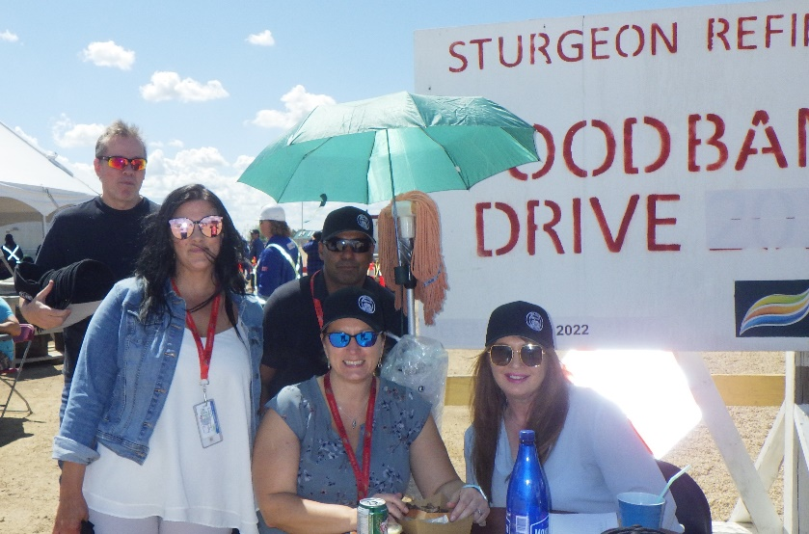
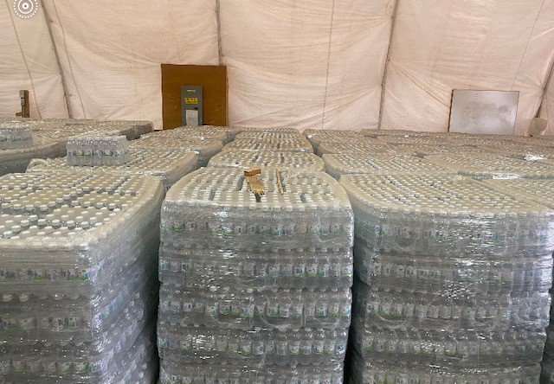
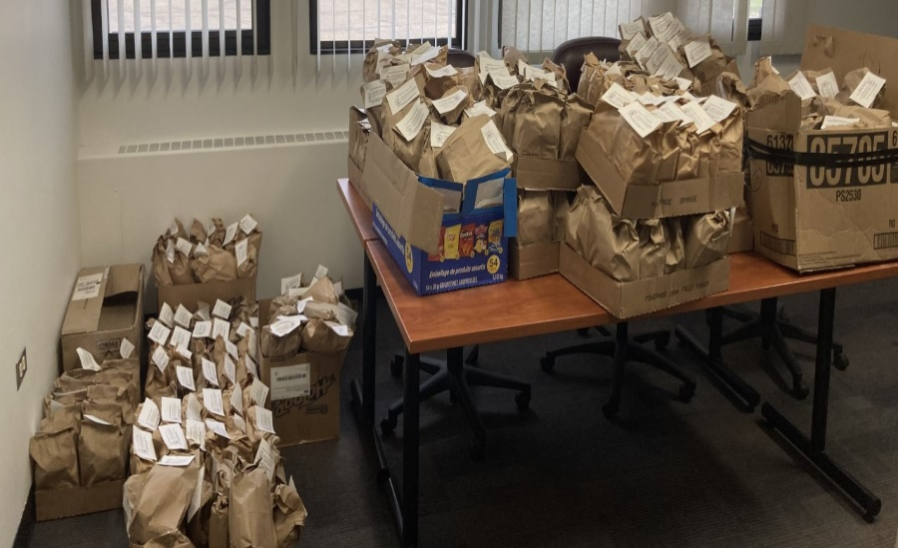
Sturgeon Refinery Turnaround Talk
Our Turnaround team:
Raised over $1,500 and hundreds of pounds in food donations for the Bon Accord & Gibbons Food Bank at the start of Turnaround.
Generated over 400 pounds of food in support of the Redwater and Bon Accord & Gibbons Food Banks in a second food drive as Turnaround wrapped up.
Donated more than 200 snack packs to a local Redwater School, along with numerous pallets of bottled water to local organizations and charities.
Photo
Placemarker
7
7

Slide 8
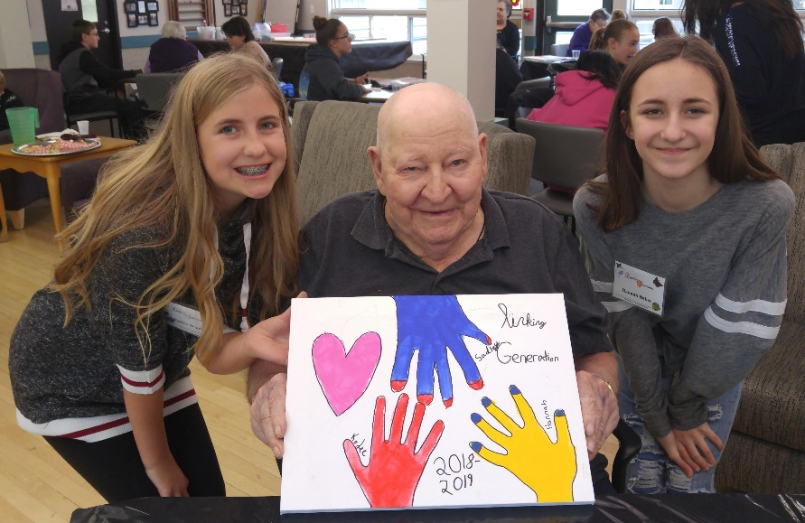
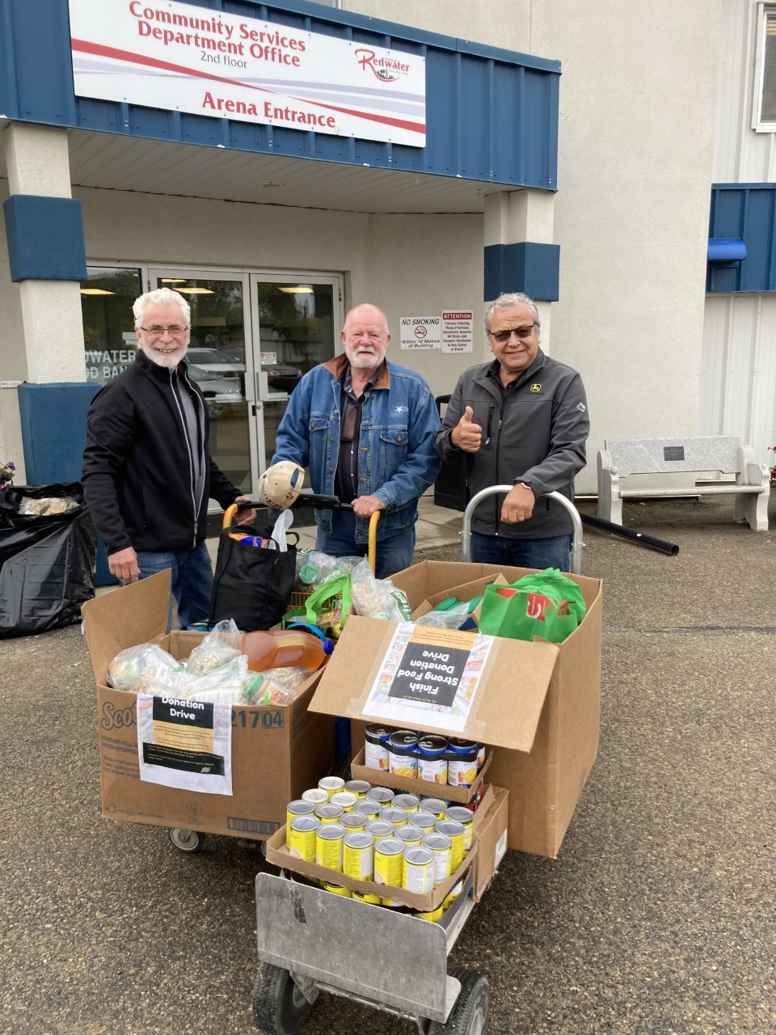
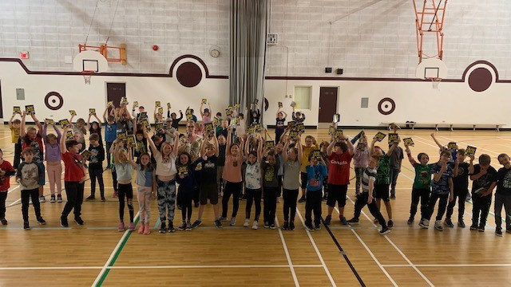
Sturgeon Refinery Helping build stronger communities
Photo Placemarker
Photo
Placemarker
Photo Placemarker
Linking Generations program
Photo Placemarker
Photo Placemarker
Books for kids—Landing Trail School, Gibbons
Redwater Food Bank
8
8

Slide 9
Sturgeon Refinery Emergency preparedness
9
9

Slide 10
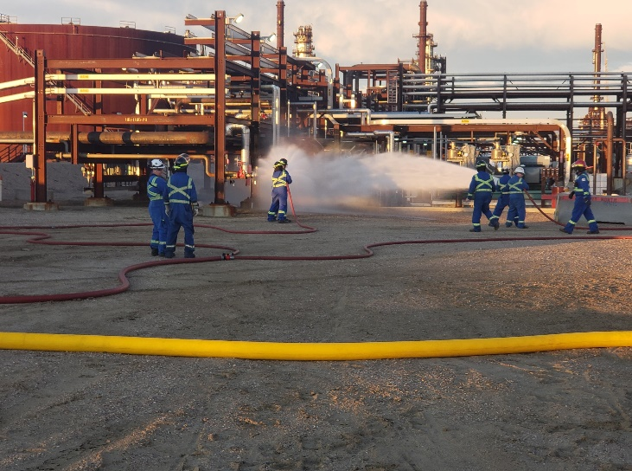
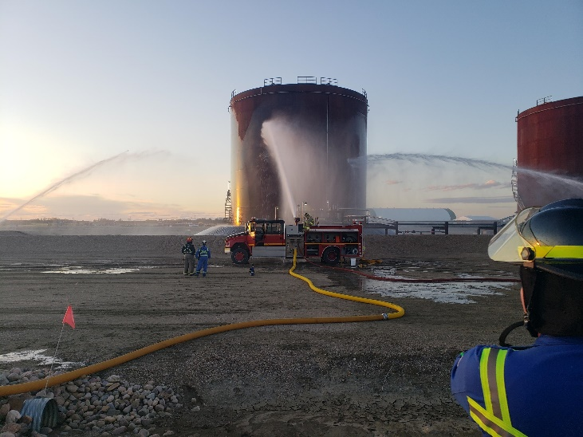
Sturgeon Refinery Emergency preparedness
Countless training hours and the ongoing dedication of the 48 employees of our Emergency Operations Centre response team help ensure our plan is in place in an emergency situation.
We work closely with the local mutual aid organization, industry neighbours and local municipalities to improve our mutual aid functionality.
Our website (nwrsturgeonrefinery.com), Twitter and LinkedIn accounts are all great ways for you to stay up-to-date on what’s happening at the refinery.
Photo Placemarker
Photo
Placemarker
Photo Placemarker
On-site emergency response training drills help ensure we’re ready if an emergency strikes.
10
10

Slide 11
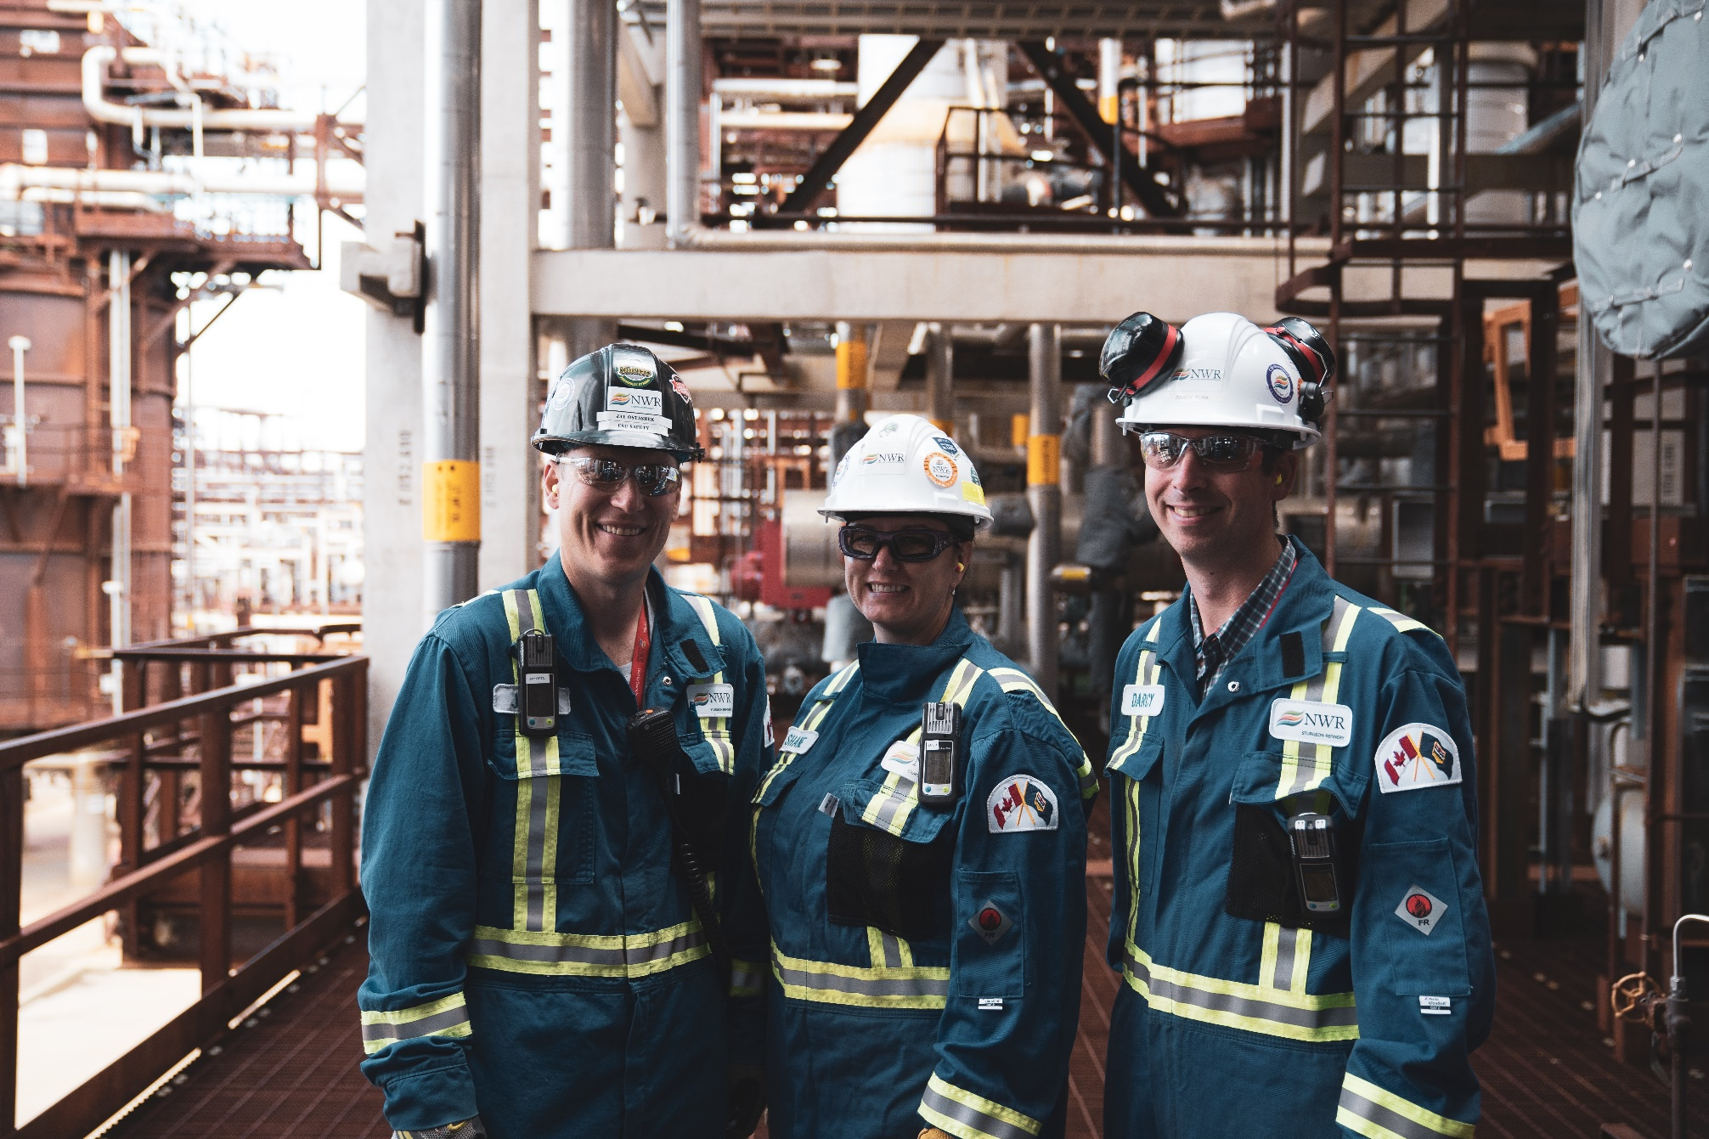
Sturgeon Refinery What’s next?
11
11

Slide 12
Sturgeon Refinery Questions?
Karla Johnston Communications Specialist 587-756-8022 KJohnston2@nwrpartnership.com
nwrsturgeonrefinery.com
12
12

