Slide 1
Inter Pipeline Heartland Region Update Brendan Curley VP, HPC Operations
September 2022

Slide 2
Disclaimer
FORWARD-LOOKING STATEMENTS
Certain information contained herein may constitute forward-looking statements and information (collectively, "forward-looking statements") within the meaning of applicable securities legislation that involve known and unknown risks, assumptions, uncertainties, and other factors. Forward-looking statements may be identified by words like ‘‘anticipates’’, ‘‘estimates’’, ‘‘expects’’, ‘‘indicates’’, ‘‘intends’’, “may”, “could” “should”, “would” ‘‘plans’’, ‘‘scheduled’’, ‘‘projects’’, ‘‘outlook’’, ‘‘proposed’’, ‘‘potential’’ ‘‘will’’, and similar or analogous expressions are intended to identify forward-looking statements. Readers are cautioned not to place undue reliance on forward-looking statements. Such statements reflect the current views of Inter Pipeline Ltd. and its subsidiaries (collectively, Inter Pipeline) with respect to future events and are subject to certain risks, uncertainties and assumptions that could cause Inter Pipeline's results to differ materially from those expressed in the forward-looking statements. In particular, but without limiting the foregoing, this Presentation contains forward-looking statements pertaining to, and Inter Pipeline have made certain assumptions regarding, among other things the implied benefits of the Heartland Petrochemical Complex, including, but not limited to the accuracy of short-term predictions related to propane, propylene and polypropylene and associated market drivers; and the anticipated availability and success of executing on ESG strategies. Any such forward-looking statements are based solely on the current expectations of Inter Pipeline but inherently are subject to a variety of risks and uncertainties that could cause actual results to differ materially from those projected. Such risks and uncertainties include, among others, the further development of its projects and facilities; assumptions concerning operational reliability; general economic and business conditions, competition, changes in political, social and economic conditions, technological changes, regulatory initiatives, compliance with governmental regulations, the possibility that the asset may not generate as much revenue as expected or may cost more to operate or acquire than expected, risks of war, hostilities, civil insurrection, pandemics (including COVID-19), and various other events, conditions and circumstances, all of which are difficult or impossible to predict accurately, and many of which are beyond the control of Inter Pipeline. The future performance of the asset and Inter Pipeline may differ significantly from the past performance of the asset and Inter Pipeline. Although Inter Pipeline believes that the assumptions underlying the forward-looking statements are reasonable, any of the assumptions could be inaccurate and, therefore, there can be no assurance that the forward-looking statements included in this presentation will prove to be accurate. In light of the significant uncertainties inherent in the forward-looking statements included herein, the inclusion of such information should not be regarded as a representation or guarantee by Inter Pipeline or by any other person that the objectives and plans of Inter Pipeline will be achieved. Inter Pipeline expressly disclaims any obligation or undertaking to release any updates or revisions to any forward-looking statement contained herein to reflect any change in Inter Pipeline’s expectations with regard thereto or any change in events, conditions or circumstances on which any such statement is based.​

Slide 3
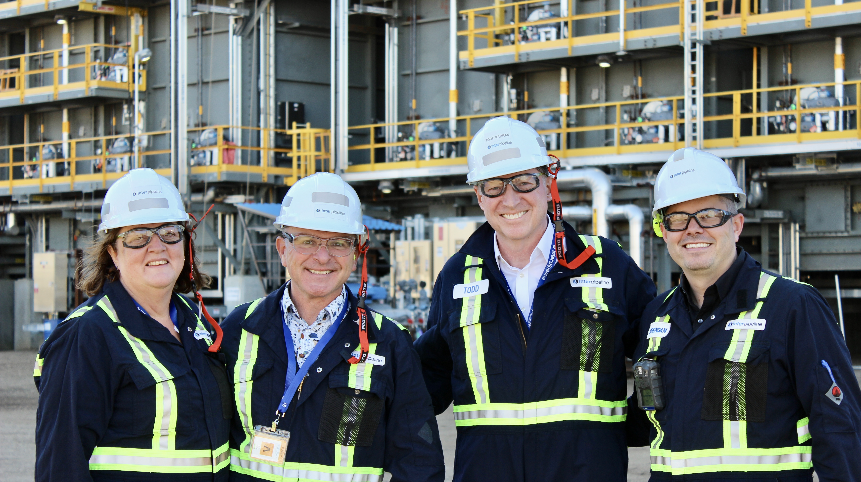

Slide 4
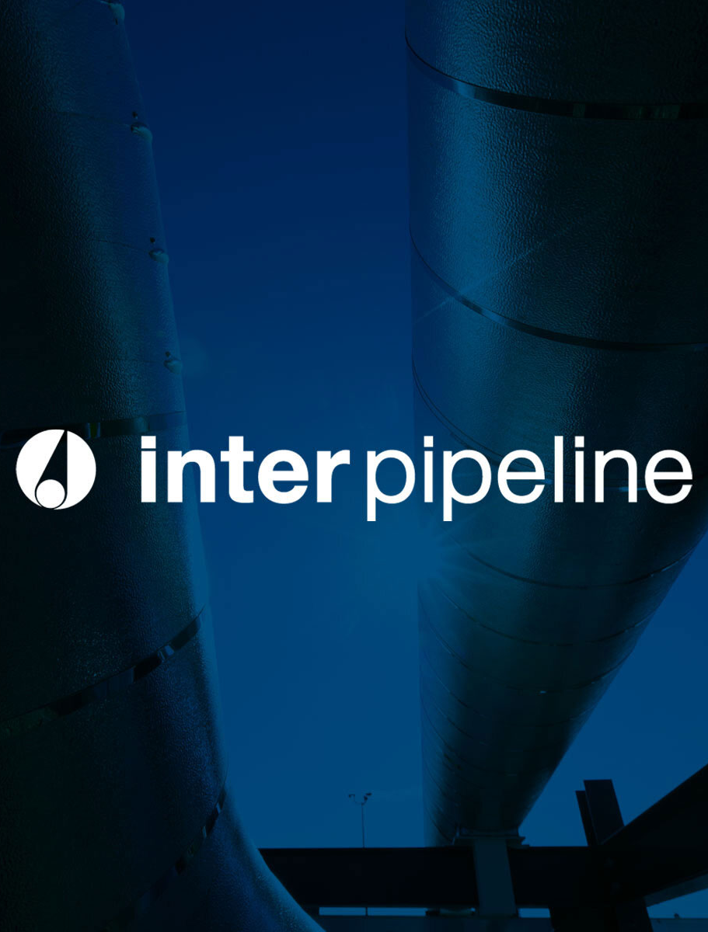
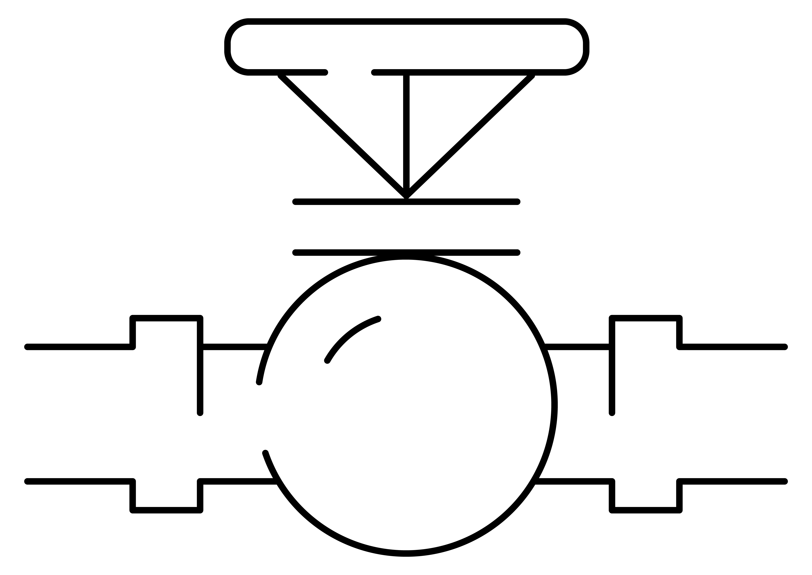
ABOUT INTER PIPELINE
World-scale energy infrastructure business
Four business segments:
Strong presence in Alberta’s Industrial Heartland with ~500 employees:
Pipeline control room in Sherwood Park
Redwater Olefinic Fractionator in Sturgeon County
Commissioning HPC, largest capital investment project in IPL history

Slide 5
Dedicated to the community
Home Safe Every Day
Over $2.8 million and 1,700 employee volunteer hours provided over 5 years to local charities and initiatives
Bottle recycling and metal recycling: invested in community.
During HPC construction, $84 million in business opportunities for Indigenous businesses
Impactful 4 years of programming with Women Building Futures
Dozens of WBF interns and grads have been employed at HPC.
Specific recruitment in Indigenous and rural communities
Skills Canada Alberta – rural and Indigenous focus for Try-A-Trade.
$10 million over 10 years to reduce plastic waste
Partnerships with NAIT, Alexander First Nation, Sturgeon and Strathcona Counties.

Slide 6
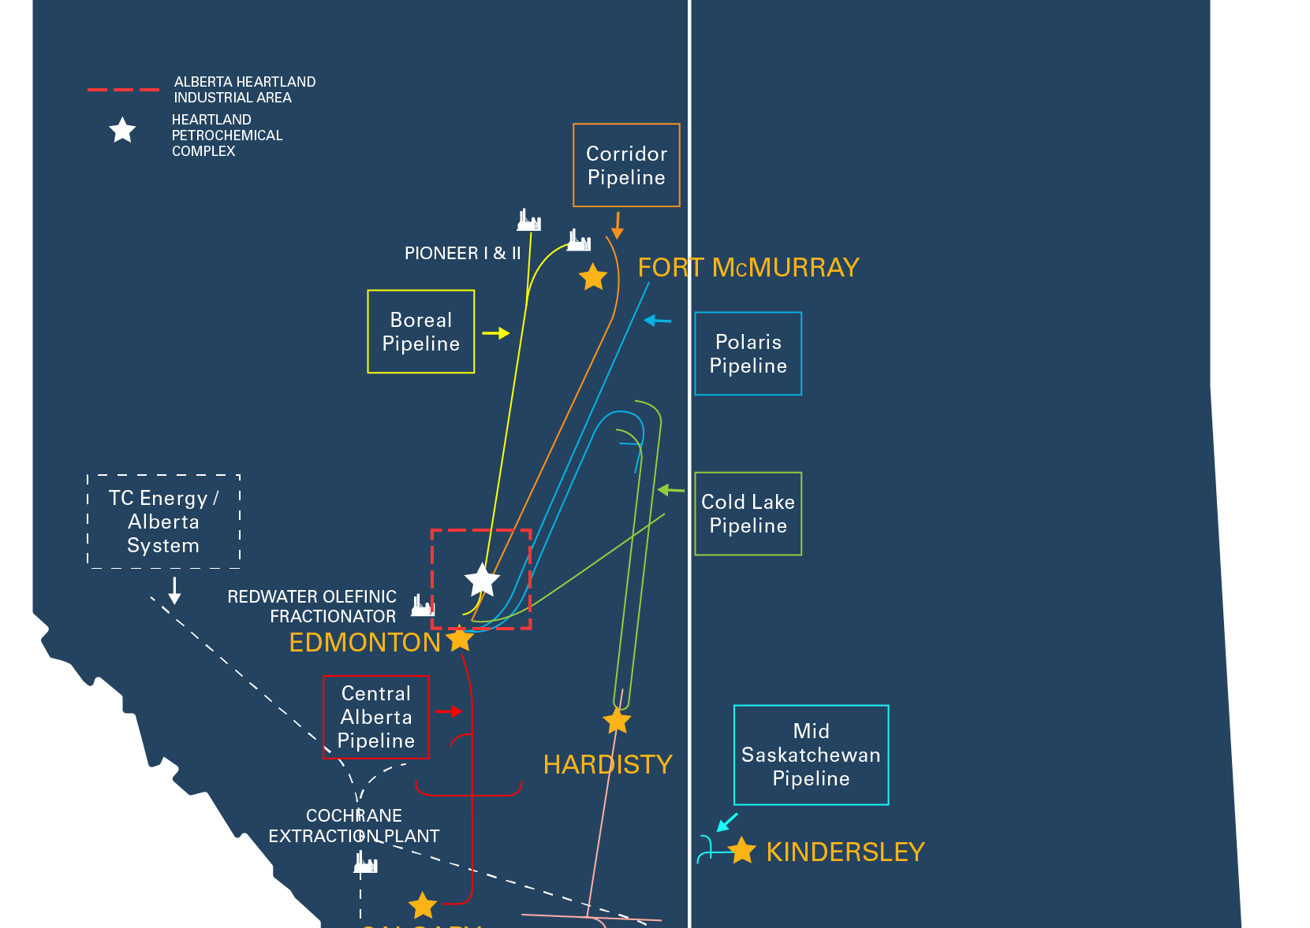
Transportation
Over 3,300 km of pipeline in area and ~8,000km of pipeline in company.
Boreal pipeline brings NGLs from oilsands upgraders to Redwater Olefinic Fractionator
Inter Pipeline ships diluent from the Strathcona region to the Cold Lake area where it is blended with heavy bitumen.

Slide 7
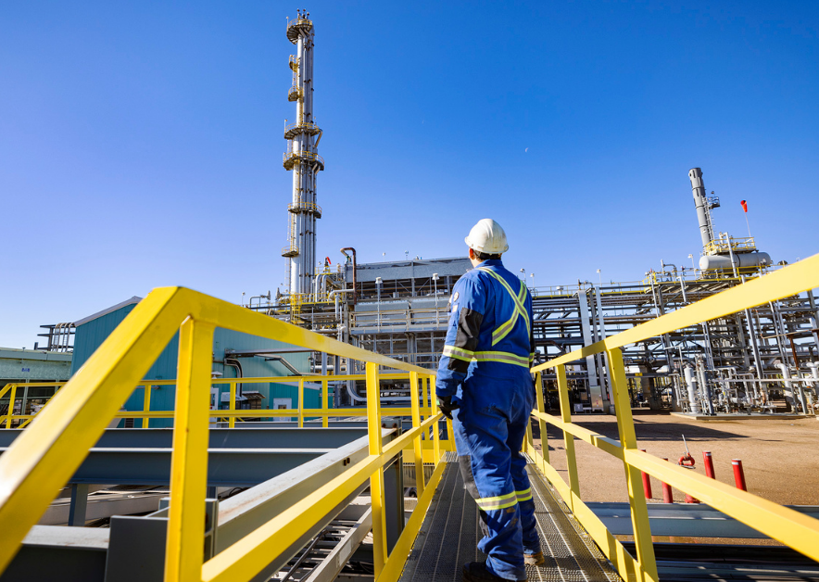
Redwater Olefinic Fractionator
Produces NGLs for sale in many markets, and polymer grade propylene that helps feed HPC.

Slide 8
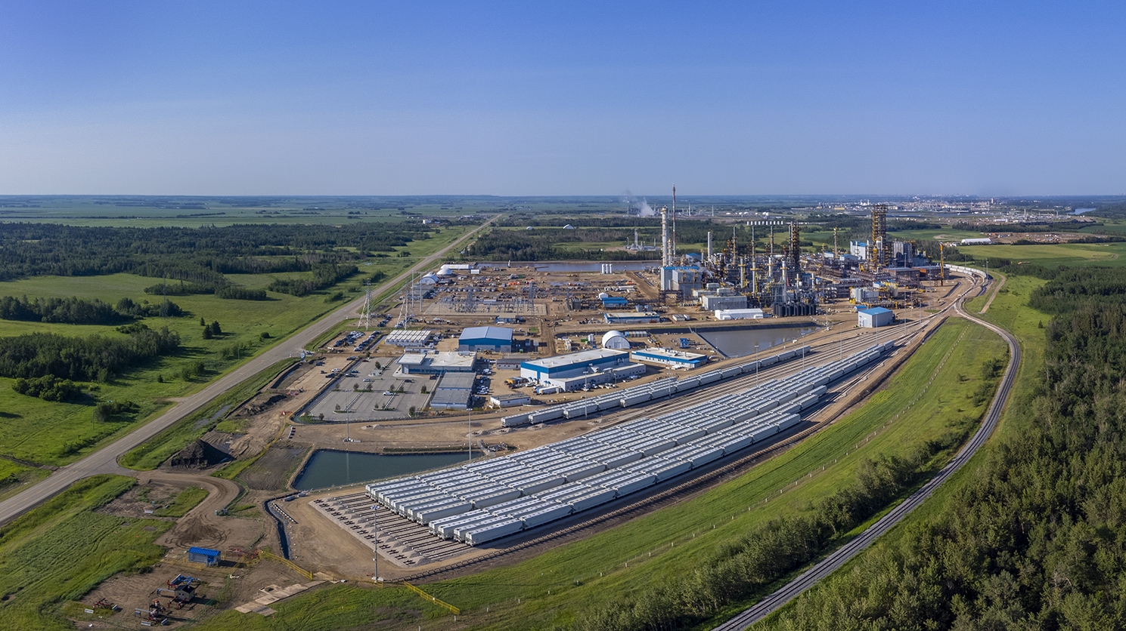

Slide 9
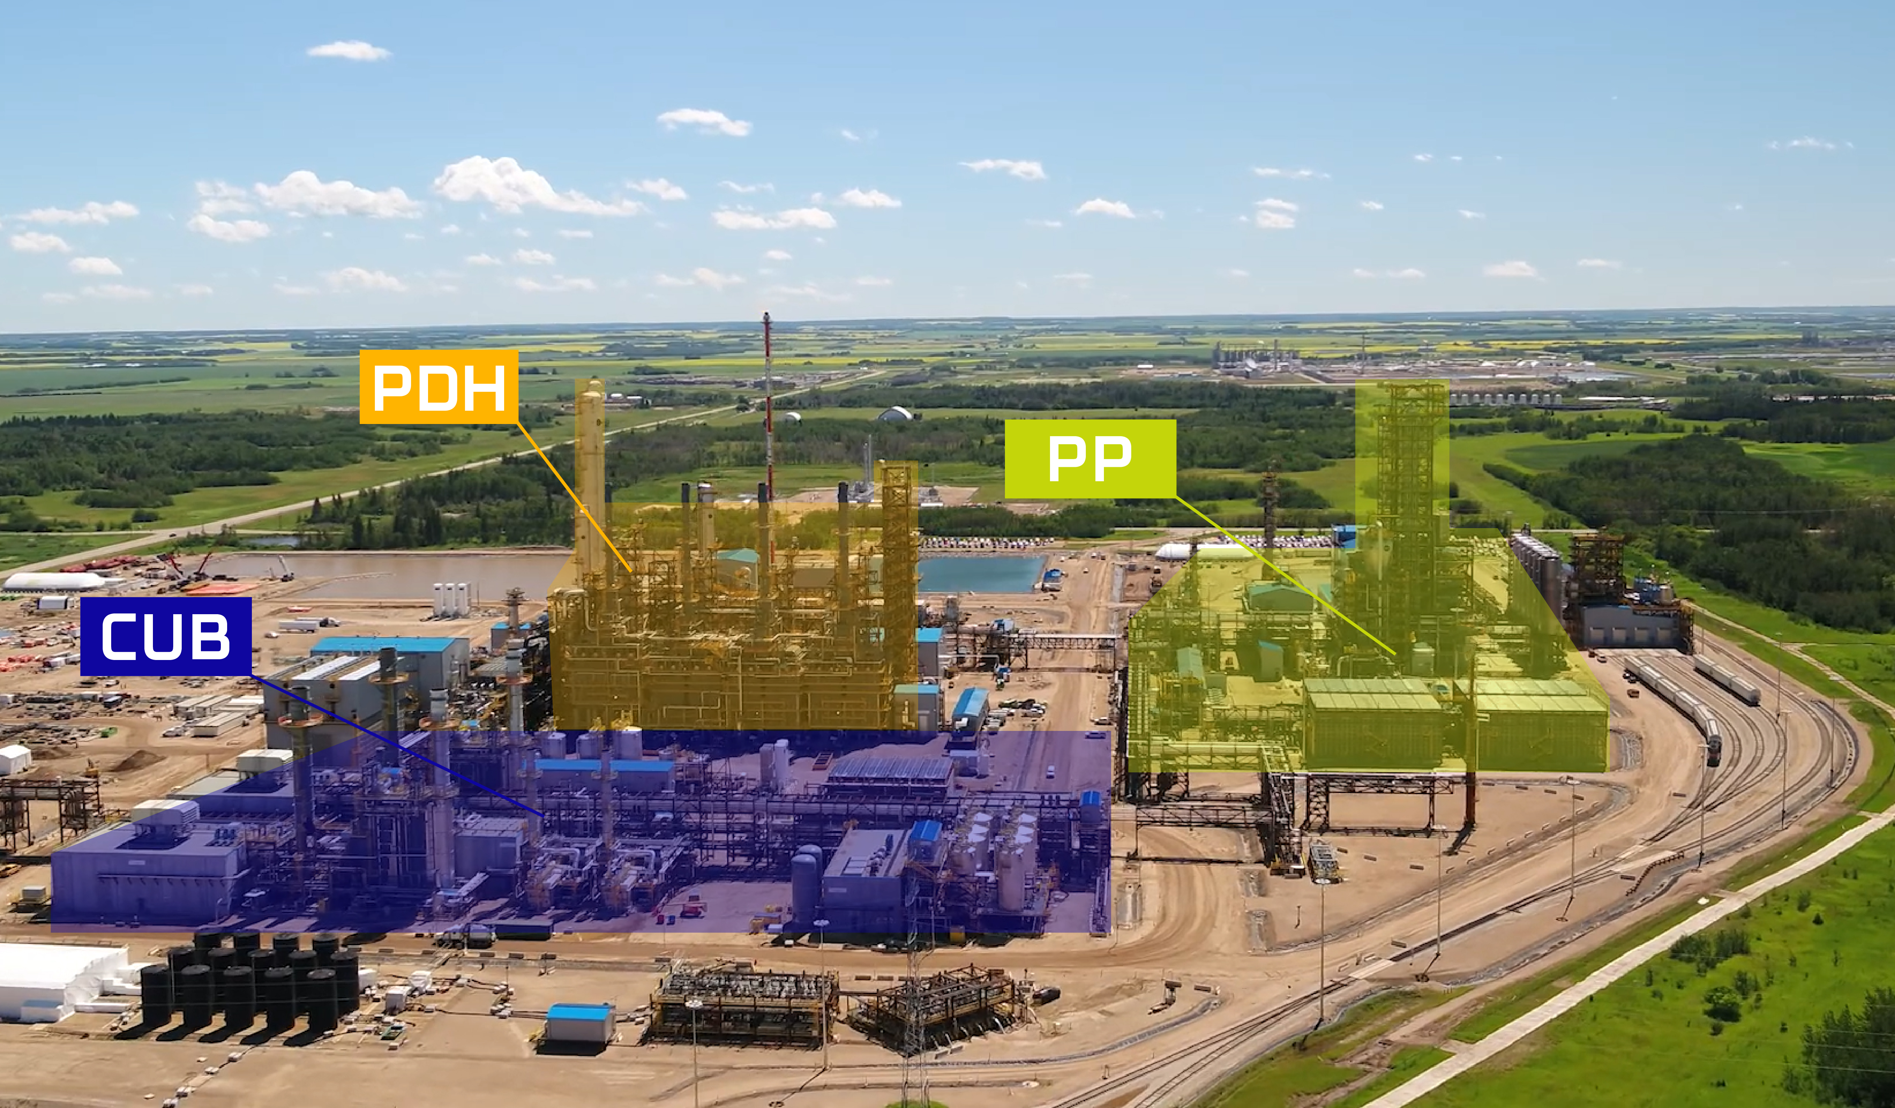

Slide 10
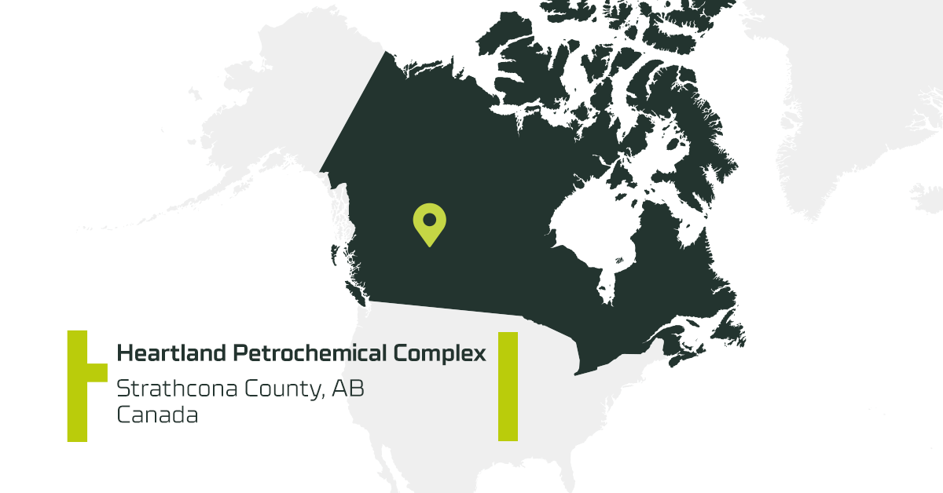
Sustainability
Advanced Technology
Reliable Supply
Geographic Advantage

Slide 11
WE’RE GRATEFUL
For you

