Slide 1
Fort Air Partnership
Life in the Heartland Update
June 2020

Slide 2

What is an Alberta Airshed Video

Slide 3
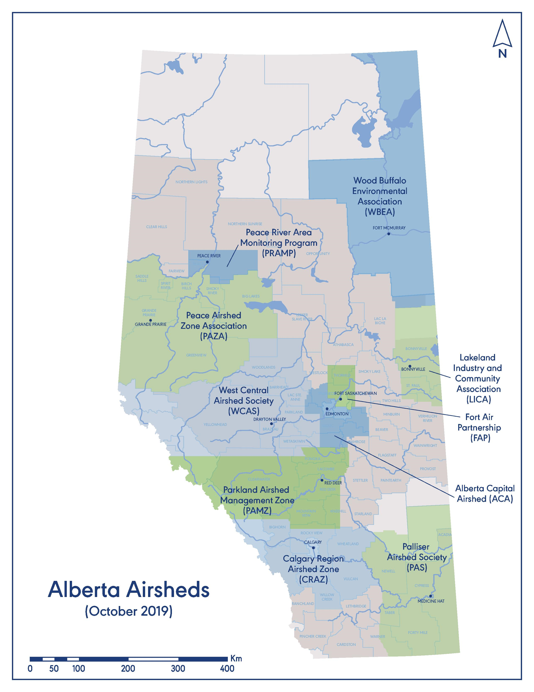
Alberta
Air Quality Monitoring:
10 Airsheds operate 83 continuous air monitoring stations across Alberta. Fort Air Partnership operates 10 of these.

Slide 4
Why Airsheds Matter
Monitoring
  10 Airsheds provide air quality data 24 hours a day, seven days a week
Air Quality and Health
  Air quality affects human health and the environment.
  Air Quality Health Index (AQHI) in over 30 communities.
Air Quality Education
Help people understand how their choices can impact air quality.
Community events and education programs.
Air Quality and Sustainable Development
Air quality data to evaluate impacts on communities and environment to enable effective air quality management.

Slide 5
Airshed Credibility
Partnership between the public, industry, Indigenous communities, non-governmental organizations and all levels of government.
Independent, third party organizations that operate on a consensus basis.
Transparent, credible air quality information is made available to everyone.
Public trust in data and support of programs.
Monitoring meets regulatory requirements for industry and also provides social license to operate.

Slide 6
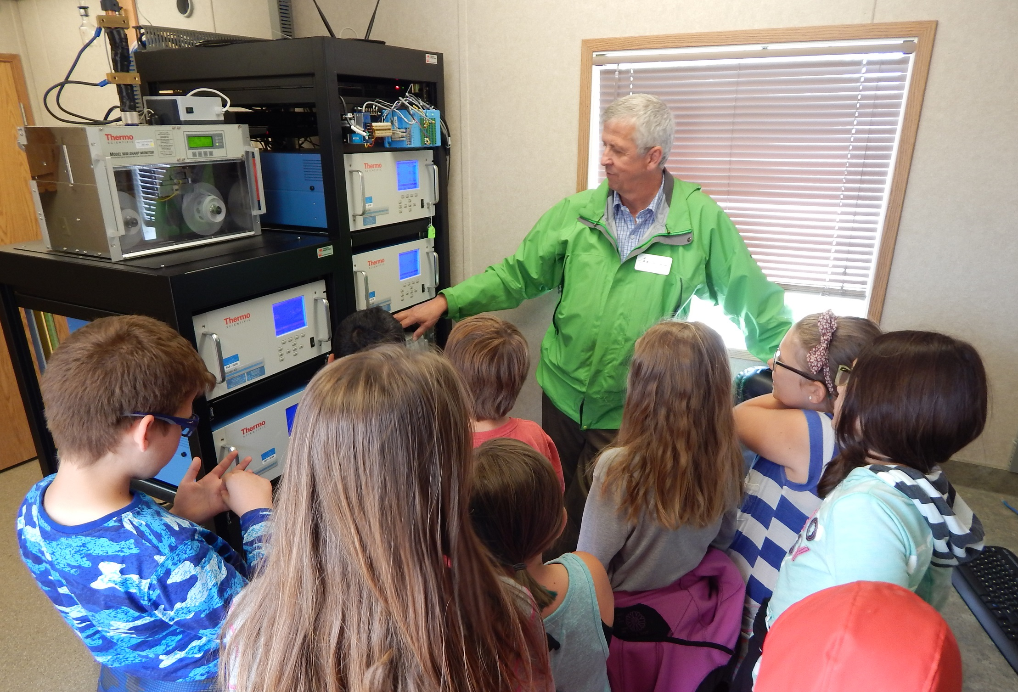
Airsheds do more than monitor
Education and outreach
Community involvement at local events
  Facilitation of multi-stakeholder dialogue around air quality issues within the community

Slide 7
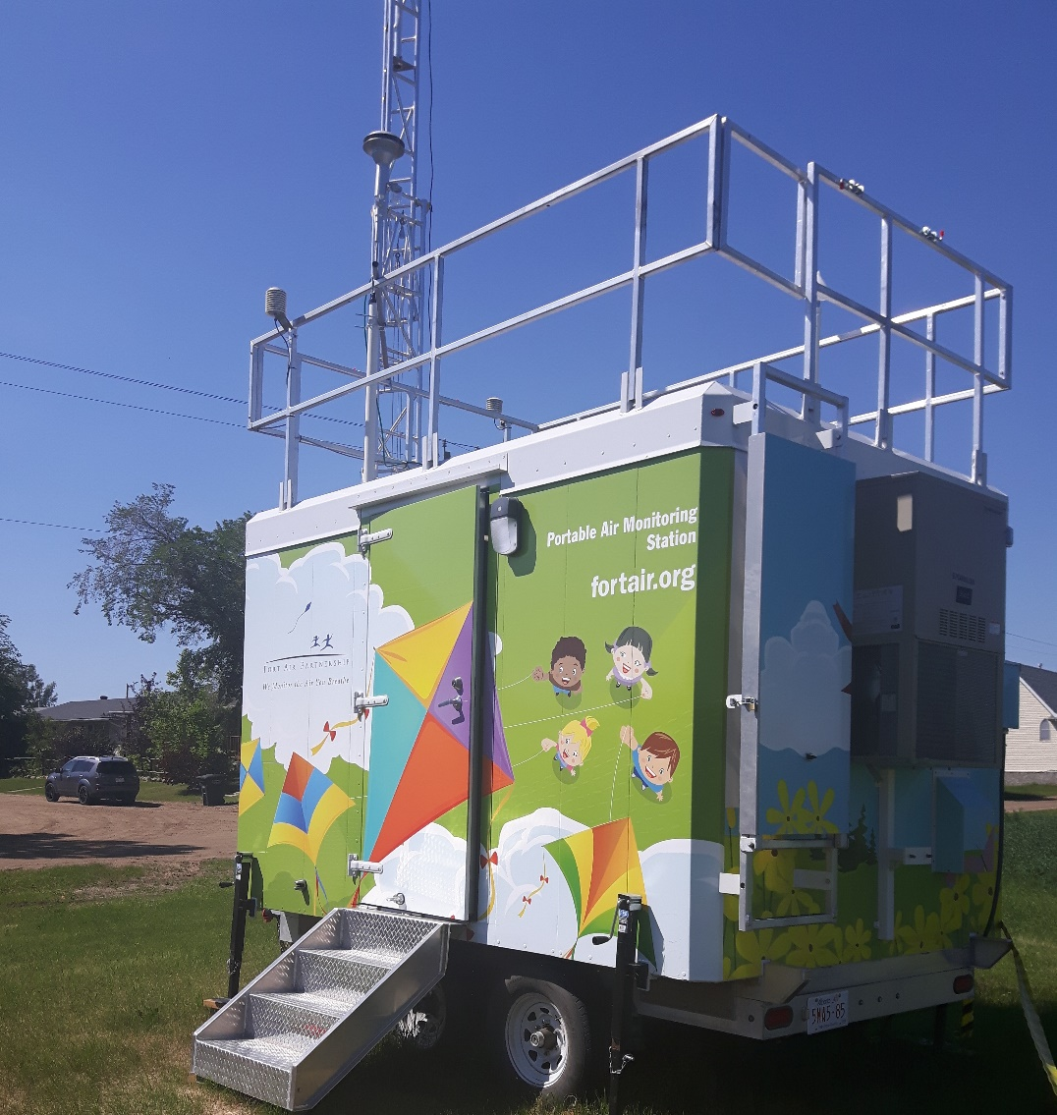
Fort Air Partnership
Independent, transparent, non-profit, multi-stakeholder organization. Established in 1997.
Mission: Operate a regional network to monitor and report on credible and comprehensive ambient air quality information.
Funded by industry, province and municipalities.

Slide 8
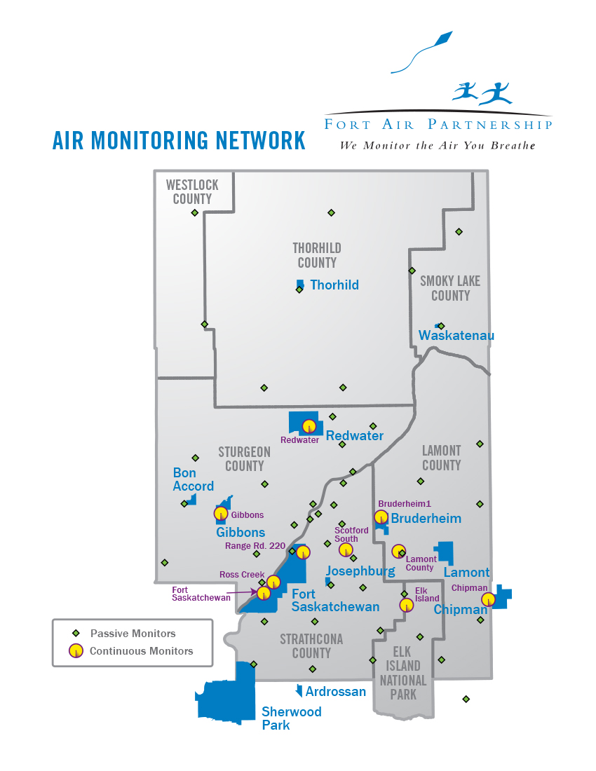
FAP Network
Boundary: 4500 km²
Monitoring Sites:
9 fixed continuous stations
1 portable station
47 passive sites

Slide 9
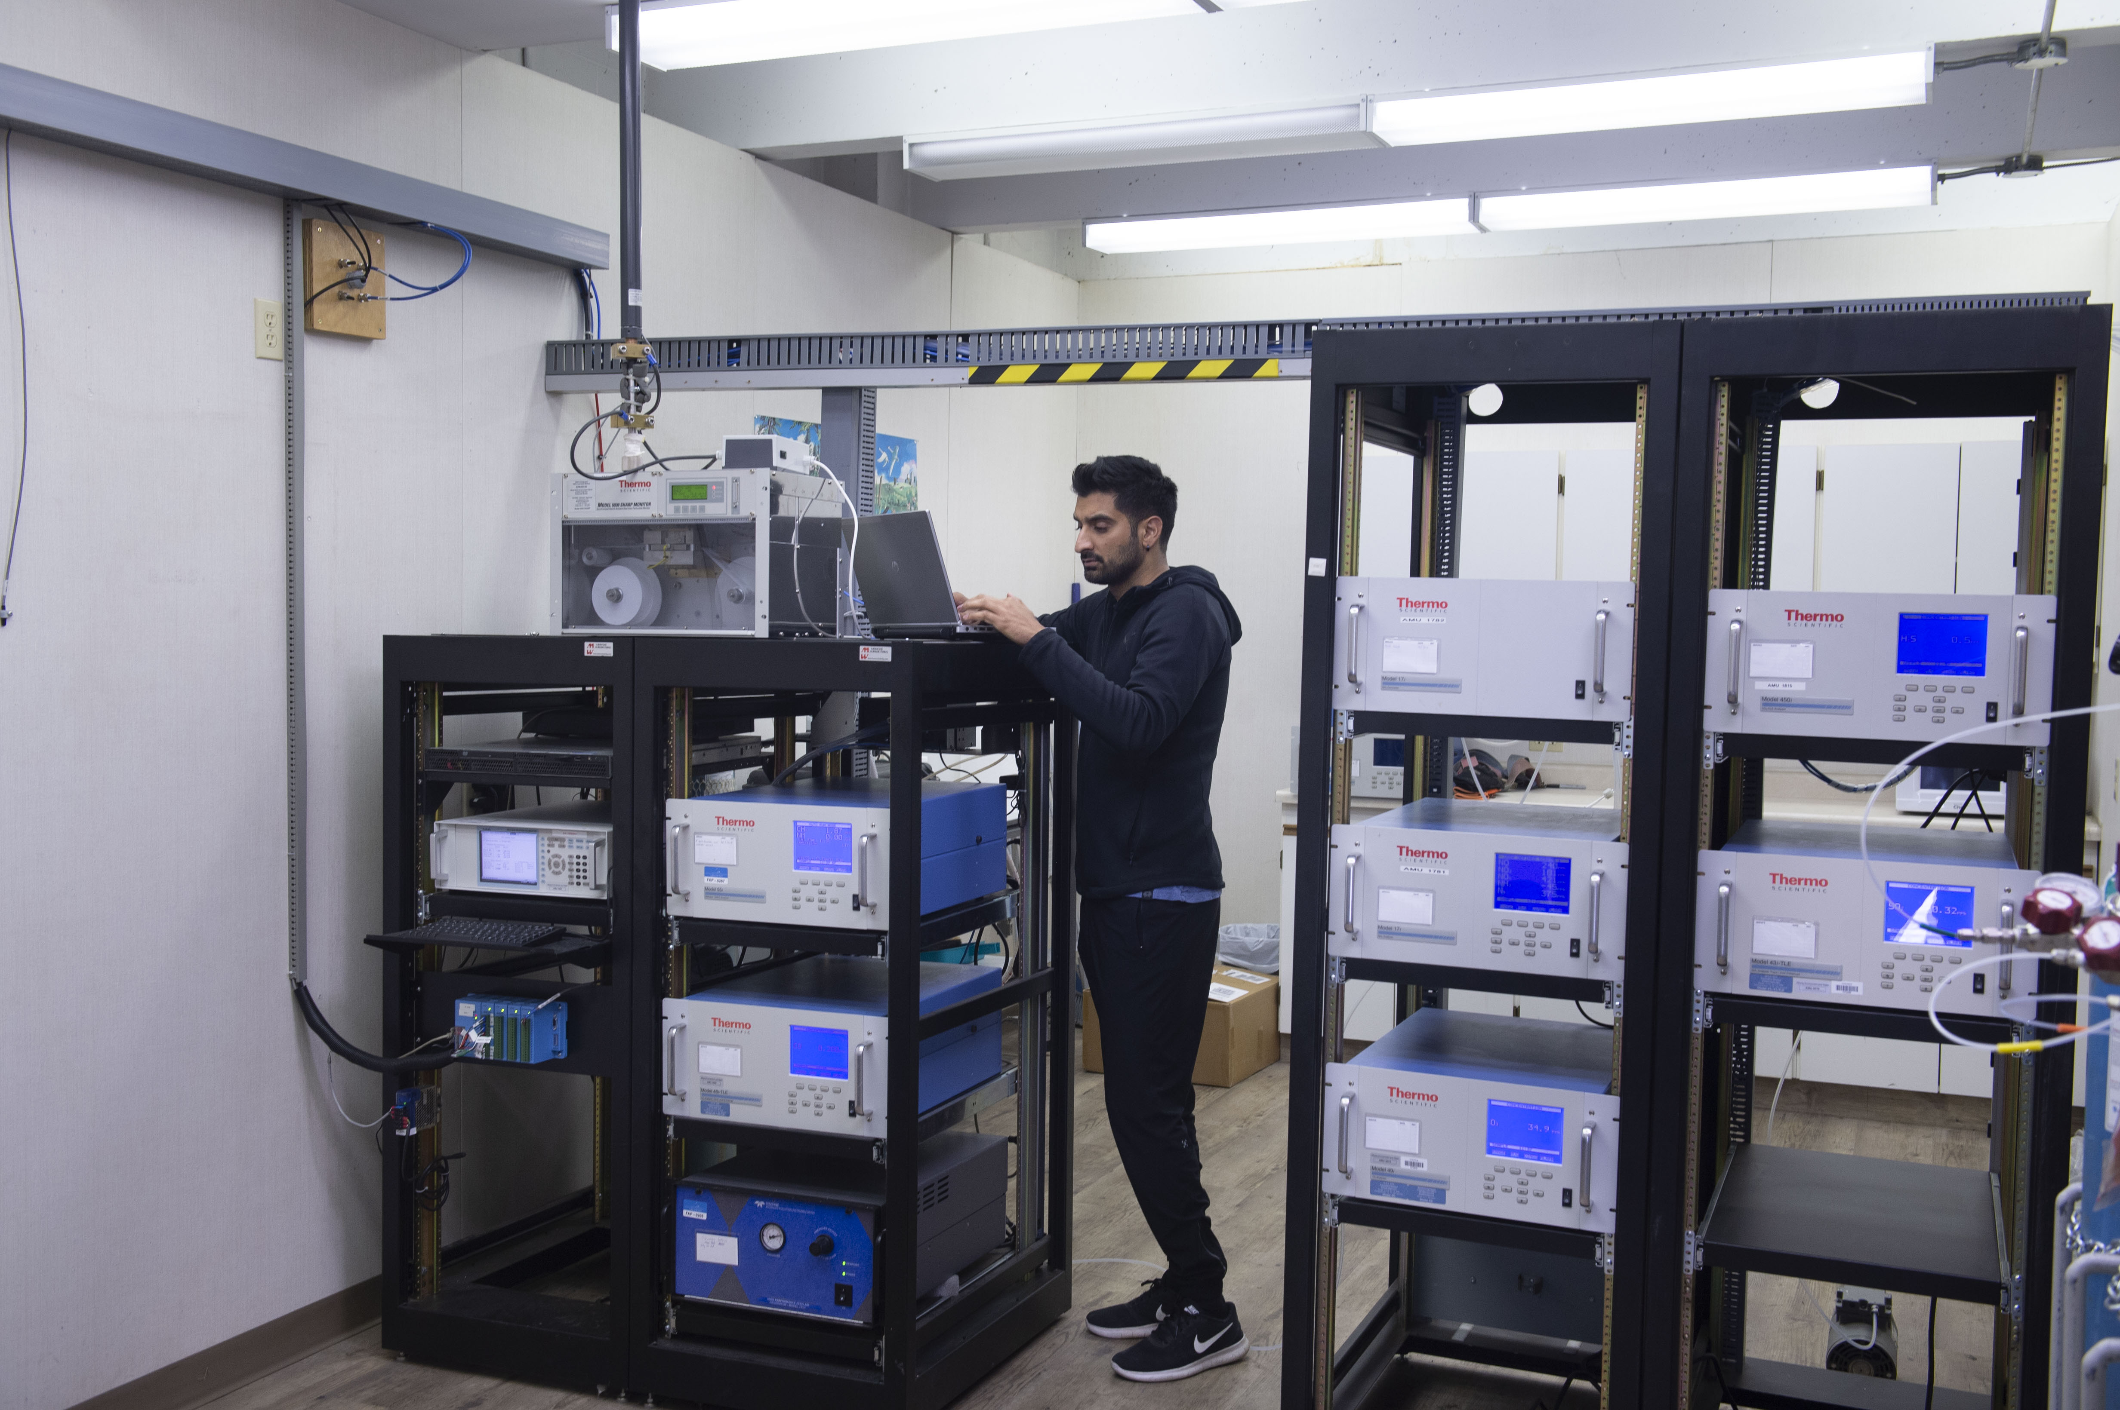
FAP Roles
  Monitor air quality where people live.
  Communicate air quality results to the public and stakeholders.
  Educate the public and stakeholders about air quality and actions and activities that can impact air quality.
Notes:
9

Slide 10
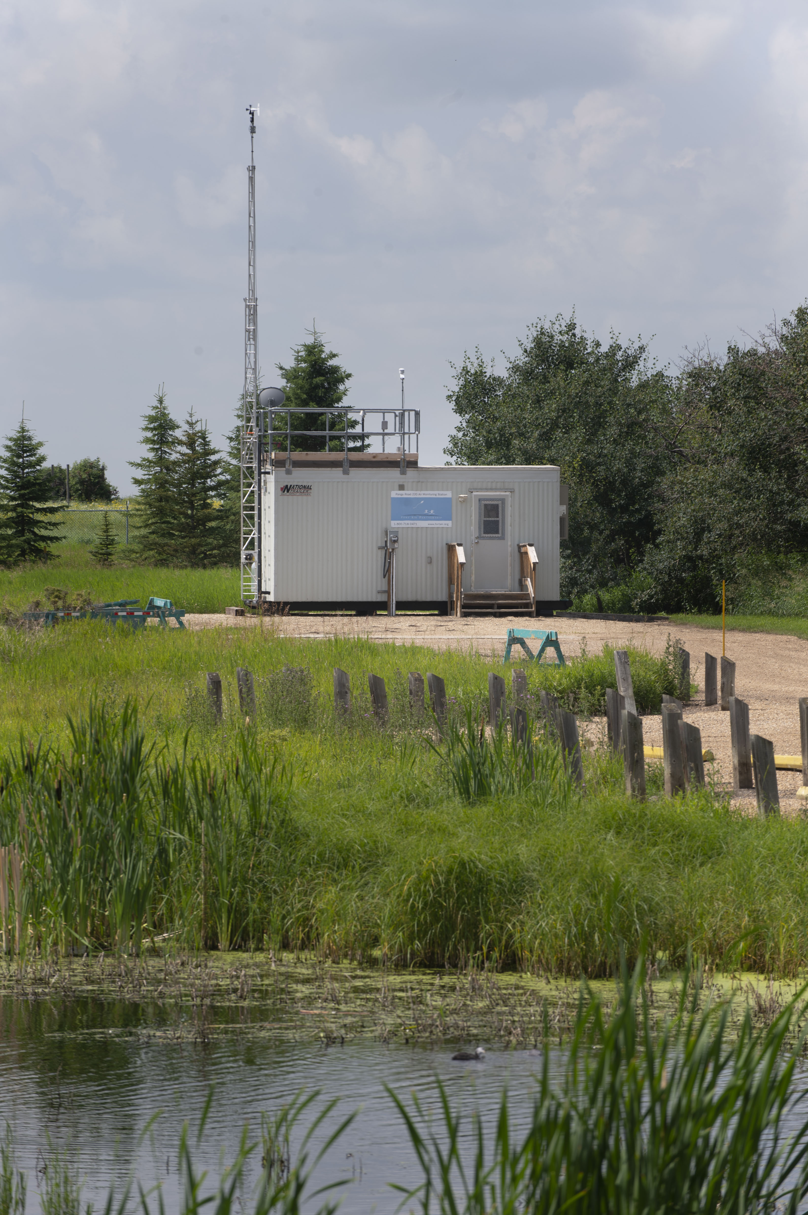
Continuous Monitoring
Measure 19 substances and weather conditions
Operate 24 hours a day, 7 days a week
Provide real time data
Report exceedances
Provide data for Air Quality Health Index calculation

Slide 11
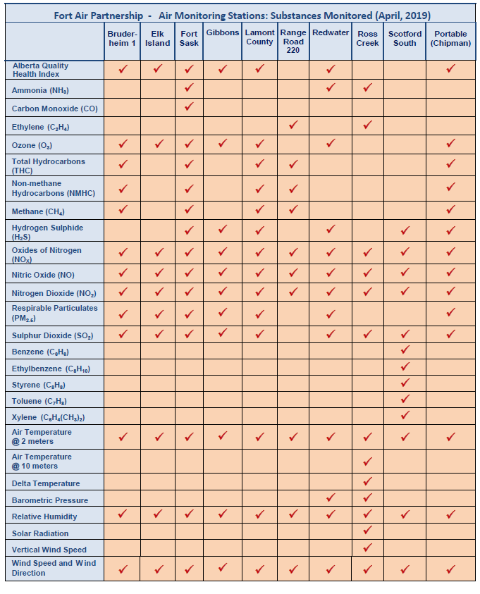
Continuous Monitoring Parameters

Slide 12
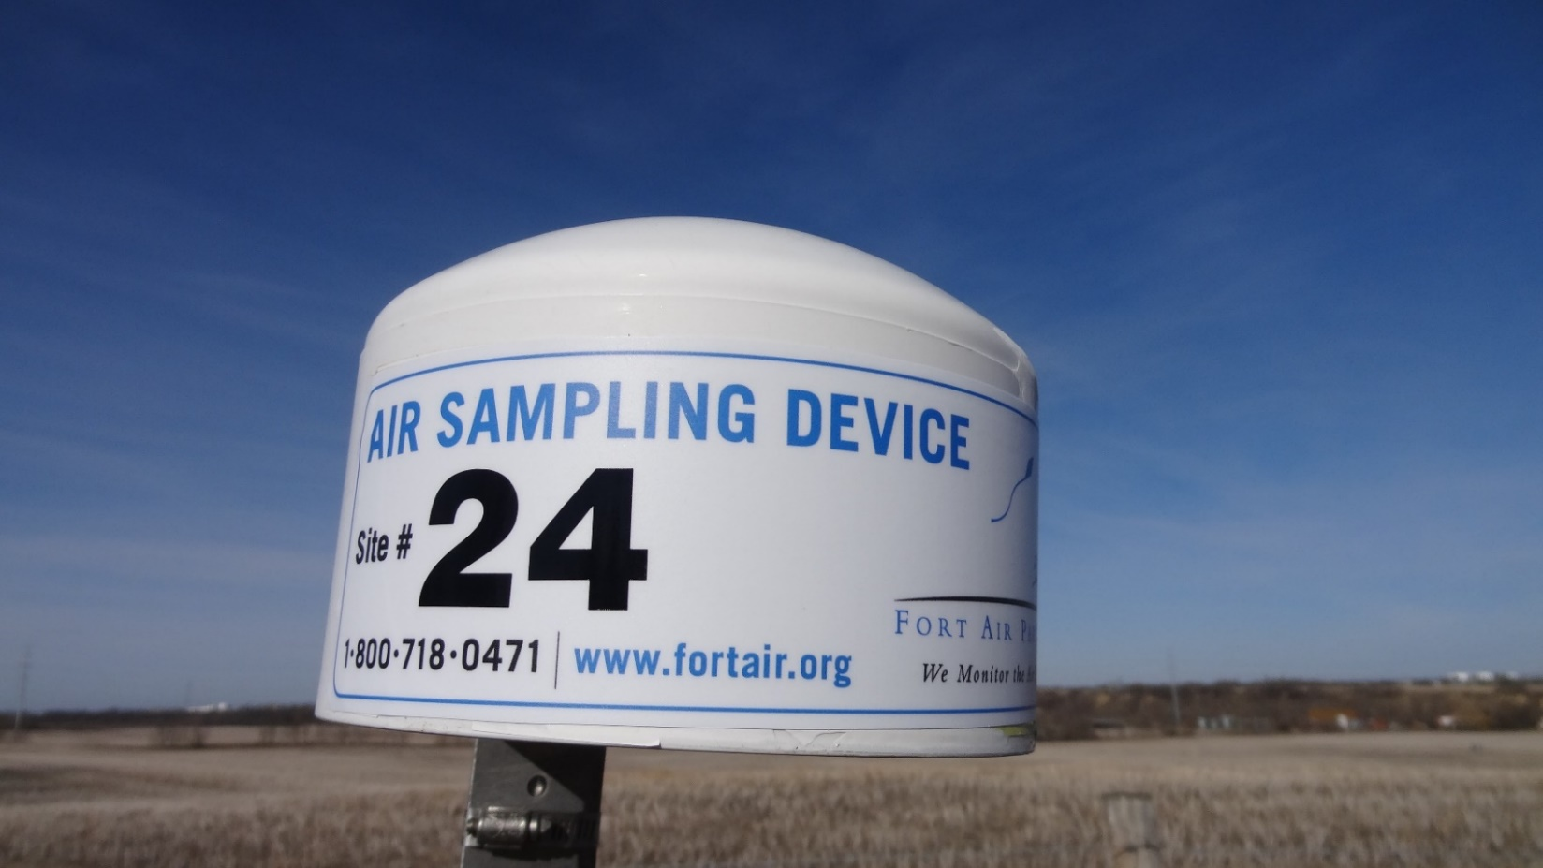
Passive Monitors
Measure two substances, monthly average.
Qualitative indicators to determine trends and future monitoring needs.

Slide 13
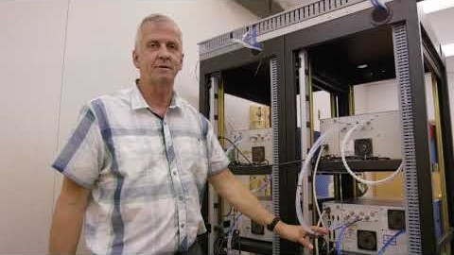
FAP Station Tour Video

Slide 14

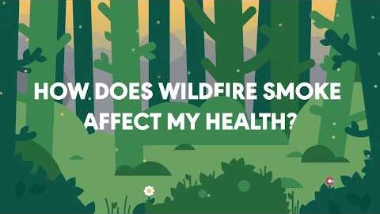
What impacts air quality?
Industry
Transportation, idling vehicles
Heating of buildings (natural gas, fireplaces, wood stoves)
Natural impacts like wildfires and temperature inversions

Slide 15
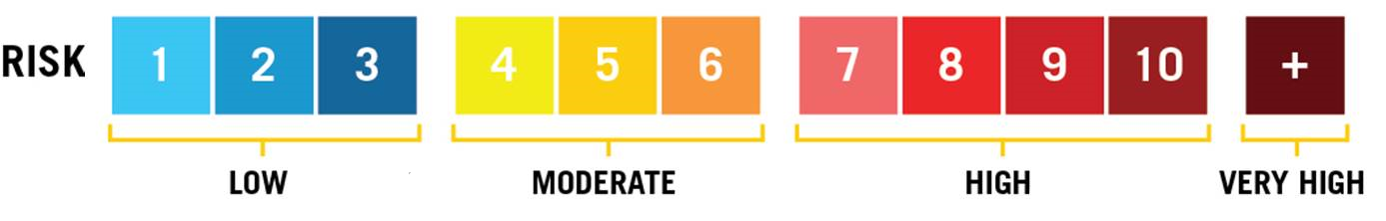
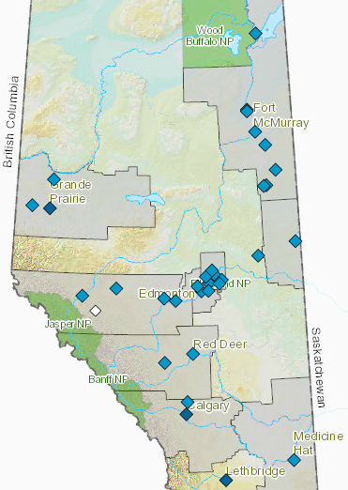
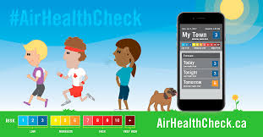
Air Quality Health Index
Measures pollutants known to affect health:
  Ozone
  Sulphur Dioxide
  Fine Particulate Matter (PM_{2.5})
  Hydrogen Sulphide
  Nitrogen Dioxide
  Carbon Monoxide
AQHI Station Locations

Slide 16
2019 AQHI results for FAP
*A total of 175 hours in high or very high risk category (102 due to smoke from wild fires, 63 due to wintertime temperature inversions and 6 due to summertime smog).

Slide 17
Air Quality Monitoring During COVID-19
As respiratory health is a factor in determining a person’s risk and response to the COVID-19 coronavirus, it is essential that residents living in and around Alberta’s Industrial Heartland continue to have access to air quality information.
With the support of our community, industry and government, Fort Air Partnership remains committed to continuing to effectively deliver air quality monitoring and reporting in the region. This includes providing data to Alberta Environment and Parks so a daily and forecast Air Quality Health Index can be calculated and communicated.
With the appropriate measures in place to protect the health of our dedicated staff and contractors, we are able to maintain a high level of data quality during this unprecedented time.
If you have any questions, or require any additional information, please contact Executive Director Nadine Blaney at nadine.blaney@fortairmail.org or call 780-289-6631.

Slide 18
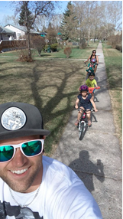
Fresh Air Experience
After a month long delay respecting COVID-19 restrictions, our 2020 Fresh Air Experience contest will launch on June 7 and close on June 30.
For a chance to win, take a selfie while enjoying a “Fresh Air Experience” in places like parks, trail systems, sports fields, dog parks or even your backyard and submit it to our Facebook or Instagram page.
We will pick a winner for the grand prize of $200, $100 for second place and $50 for third place on July 3. See contest rules for more details.

Slide 19




Additional Information:
At fortair.org:
Access air quality monitoring news and information
Sign up for FAP’s e-bulletin
Download the AQHI app
Ambient Air Data Warehouse: airdata.alberta.ca

Slide 20
Thank you
Questions?
Contact: Nadine Blaney
FAP Executive Director
nadine.blaney@fortairmail.org

